Slide 1

Medical Records
Group 39
81613 - Mafalda Ferreira
83496 - Leonardo Epifânio
83540 - Pedro Lopes
Notes:
Our project is a cloud-based system to access Medical Records

Slide 2
Motivation
A patient’s medical history is highly sensitive data.
This information must be kept private and only responsible staff can access it.
Every health care institution must have access to this kind of information so that the patients can receive healthcare anywhere, at all times.
Notes:
Medical records ease the process of diagnostics and ensure its quality
Problems:
A patient’s medical history is highly sensitive data.
This information must be kept private and only responsible staff can access it.
However, every health care institution must have access to this kind of information to ensure health care to everyone everywhere.
We have many entities, and we must restrict and give access to the entities depending in policies.

Slide 3
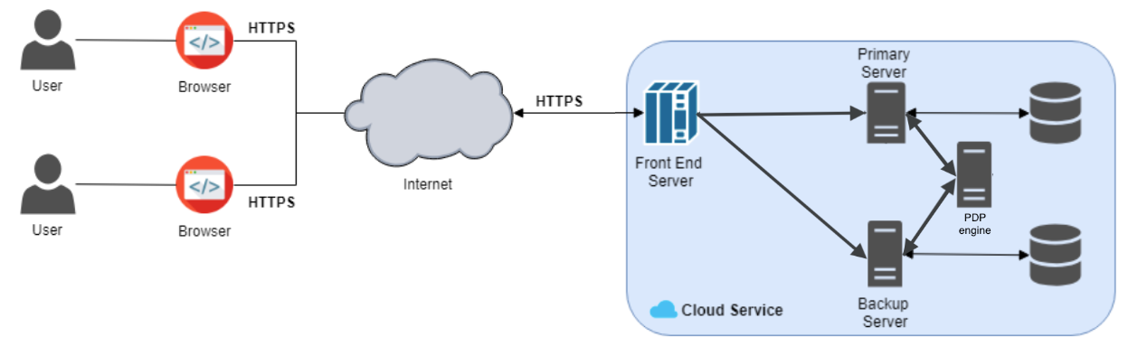
Architecture
Notes:
We created a web application to make a cloud service.
We have the users, they can access the system through a browser.
Their communications are secured using HTTPS.
In the cloud, we assume that all communications are secure.
We receive a request in the Front-end server and then we forward to the primary server which executes it.
To ensure high availability we have a backup server, in case when the primary fails, the backup server takes its place and starts executing the requests. Thus, we achieve fault tolerant and the fault is hided from the client.

Slide 4
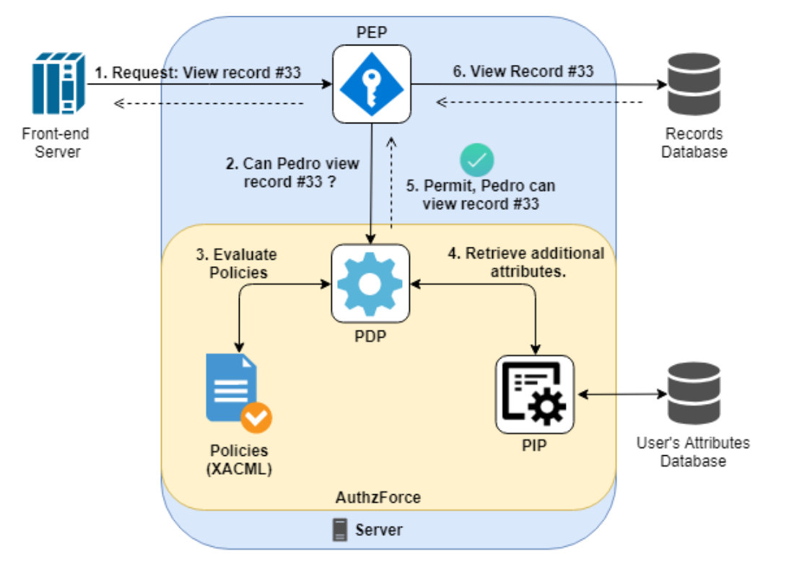
XACML Architecture
Notes:
As I said, we have many entities and we must manage the access privileges to the records and actions. To achieve this we use XACML architecture and a XACML engine called AuthzForce.
There are two model accessing control: Role Based (where is defined around roles and privileges in each role) and Attribute Based (defined using a combination of attributes).
In our project, we have roles, but roles itself are not enough. Because a doctor cannot see all existing medical records just because is a doctor.
A policie can be, a doctor can only see the medical records of its patients. Those are attributes. Therefore we use ABAC.

Slide 5
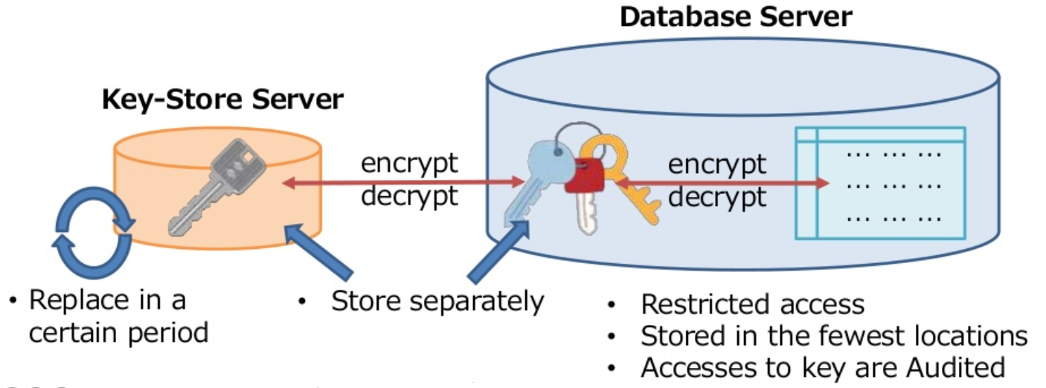
Database Security
KeyStore
Notes:
The application and system data are stored in a MariaDB database (mysql).
The data is encrypted using several keys, one for each table.
These keys are in the server filesystem, encrypted by a master key, which is then saved in RAM, as the database service starts up.
So, while the database system is up, the master key shouldn’t be in the server filesystem.
The point is to, for example, have the key in a pendrive, and when you start up the database service you insert the pendrive, and when it’s up and running, you can remove it.
The encryption algorithm we used for the tables, was AES with cipher block chaining.

Slide 6
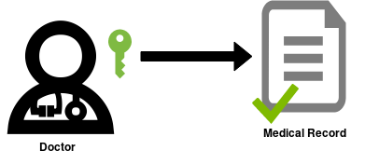
Certificates
Signature = {Hash(MedicalRecord)}_{Kpriv}
Notes:
When a citizen is created in the system, a Public/Private key pair is attributed to him.
These key pairs are saved in a keystore file, in the server, protected by a password.
When a medical record is created or updated, it is signed with the doctor’s private key, and that signature is stored along with the record. This is a way to assure integrity, and also to enforce non-repudiation.
Each time we get a medical record from the database, this signature is verified.
In the other actions applied on the system data (role attribution, citizen creation, etc...), the way we assure non-repudiation is by saving the identificator of the author of that action, along with the corresponding data in the database.
For example, when an admin assigns a doctor to a hospital, the identificator of this admin is saved along the data of the doctor.
Since the users are authenticated when they execute these actions, they cannot repudiate them.
The encryption algorithm is RSA with a keysize 2048, and hashing is done with SHA-2

Slide 7
Live Demo
https://drive.google.com/file/d/1ACUZ0v0FjCS5Oma4jMgexWGHGcHQYFJc/view?usp=sharing

